Slide 1
A company with tradition, a brand of quality, a team with power.
June
2024
Radium presents Radium.

Slide 2
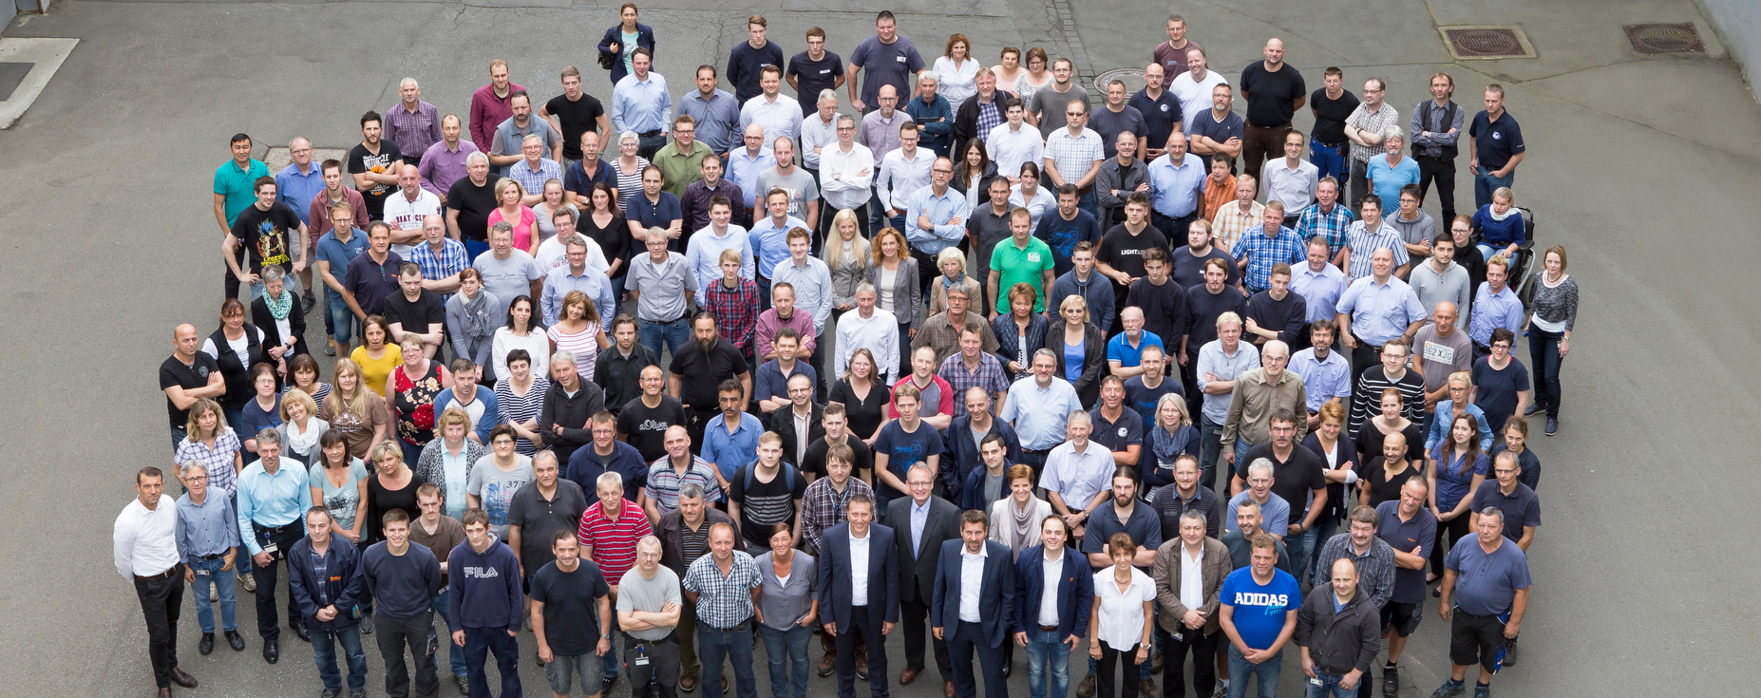
We make the difference.
Our Staff, our Team, our Radium.

Slide 3
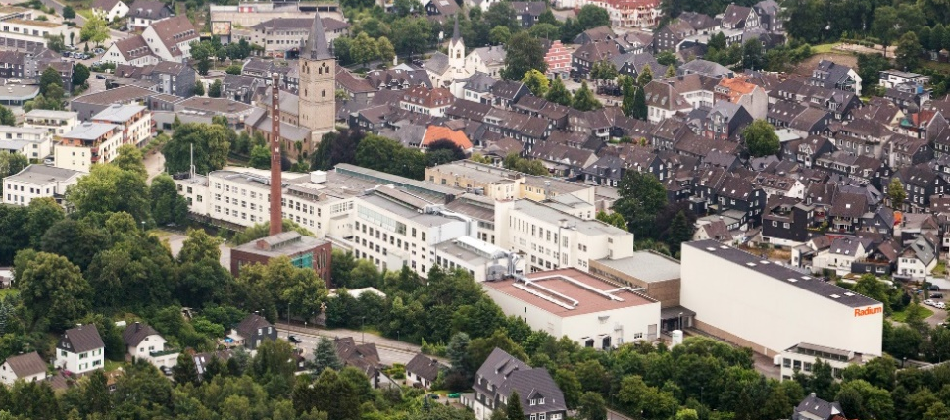
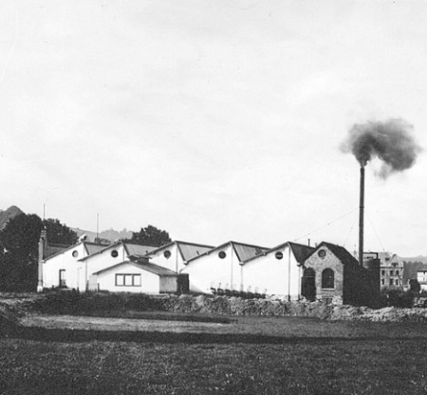
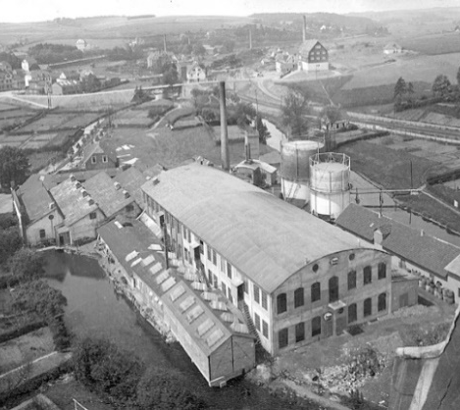

Radium at a glance.
The jewel of the lighting industry.
Oldest active German lamp manufacturer
Headquarters in Wipperfürth: production, development and sales location for Radium products
International sales and service orientation
Medium-sized company structure with highest demands on quality and flexibility

Slide 4
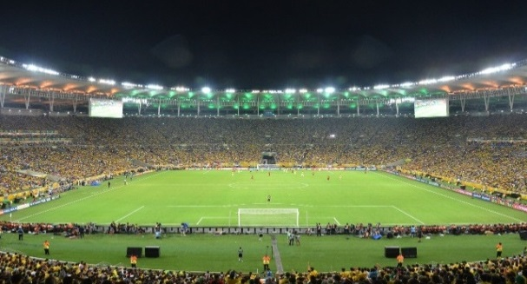


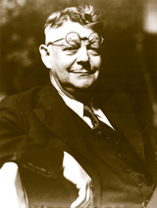
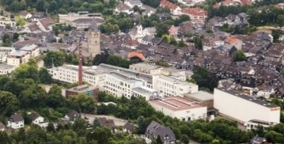
The basis for solid growth.
Strong foundation, strong roots.
Important milestones in the company's history
1904
Foundation
On January 29, Richard Drecker and Adolf Berrenberg - an employee of Edison in the USA - founded the "Berrenbergsche Electricitätswerke GmbH". In the same year, the company was renamed "Radium- Elektrizitäts-Gesellschaft m.b.H.".
1967
Technical breakthrough
Color television went on air: Radium lit up the studios - and the game show "The Golden Shot" could be broadcast brilliantly.
2014
FIFA World Cup in Brazil
World Cup in Brazil: 8 out of 10 stadiums are illuminated with floodlights from Wipperfürth. The German national team becomes world champion under our lighting!
1904
1917
1967
1972
2014
2021
1917
Change in management
Eugen Kersting took over the management together with Richard Drecker. Under his technical leadership, Radium entered a golden age of impressive developments and far-reaching technical progress.
1972
Showing competence
Radium equipped all sports facilities at the Olympic Games in Munich with especially developed lamps.
Today
Tradition and experience
As Germany's oldest active lamp manufacturer, Radium produces innovative lighting technologies on highly industrial production lines for worldwide demand.

Slide 5


The region of light.
Germany, North Rhine-Westphalia, Wipperfürth.
anno 1904
Oldest active German lamp manufacturer
~ 180
Employees
Reykjavik
Located in the heart of the German lighting industry
Oslo
Helsinki
Stockholm
Tallinn
Riga
> approx. 15%
of total sales through export
Dublin
Copenhagen
Vilnius
Minsk
> 30
Companies in the lighting industry in the immediate vicinity
London
Amsterdam
Berlin
Warsaw
Kiev
Brussels
Wipperfürth
Prague
Bratislava
Paris
Luxembourg
Vienna
Budapest
Chisinau
Bern
Ljubljana
Zagreb
Belgrade
Bucharest
Rome
Sarajevo
Sofia
Madrid
Podgorica
Tirana
Skopje
Münster
Zumtobel
Lisbon
Athens
Lite-Licht
Pintsch
Bamag
Hecker
Glas
e:cue/Traxon
Essen
BJB
Trilux
Hella
13
Product groups for lighting in the portfolio
# 3
Market share in Germany according to GFK
Ansorg
Jordan
Siteco
Bega Meyer+Sohn
Alanod
Jung
VS
Luminaire manufacturer
Hoffmeister
HEP Werdohl
Gira
Berker
Bender+Wirth
Starting material suppliers
Düsseldorf
DIAL
Erco
Wila
Electronics / Control
Traxon
Stadtfeld
Turck
Insta
Kreon
Vectron
Köln
Marburg
Oktalite
POC Breidenbach
Rsl
MCT

Slide 6
Important highlights.
Radium Lampenwerk GmbH.
We aim to become a leading full-fledged supplier of a broad portfolio of lighting products in attractive and profitable niche segments.
  Leading and renowned lighting brand - brands in >80 countries
  High-end operating facilities in Wipperfürth
Direct and international customer access
Integrated player with all internal competencies
Strategically advantageous locations
Qualified and experienced workforce
  Comprehensive general lighting portfolio and professional niches
  Profitably operated company

Slide 7
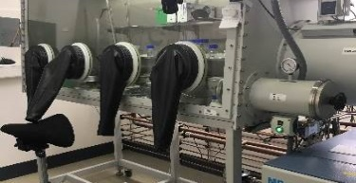
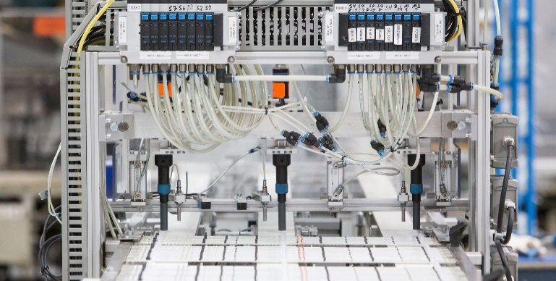
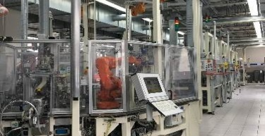
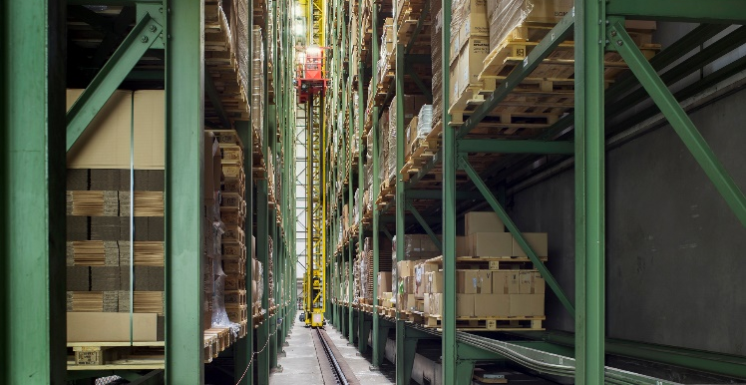
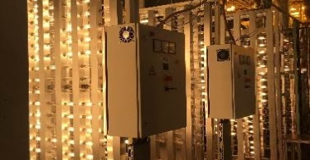
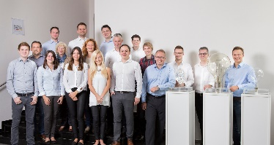

A complete value-added chain for complete autonomy.
Pre-product, precede, present fulfilment.
I
II
III
IV
V
Innovation & Development
Production& Processing
Logistics & Distribution
Quality & Testing
Sales & Marketing
  Development of proto-types in collaboration with customers/technology leaders (e.g. 3D printing)
  Development activities in the field of LEDs and smart lighting
  Patent-protected innovation in chemical and other precursor materials secures competitive advantages
  Highly automated and already existing production facilities with robots used there
  Versatile production of a wide range of traditional and LED light sources
  Conversion, maintenance and adaptation of highly specialized machines
  Procurement of input materials and lamps (merchandise) from several sources
  In-house logistics with automated high-bay warehouse with approx. 20 storage levels
  Proven expertise for complex and transnational goods deliveries
  On-site light lab with special measurement facilities, e.g. for spectral analysis
  Testing of all chemicals developed in-house to ensure the highest standards of lamp quality
  ISO certificates for process quality, environment and energy are available
  Radium products are sold via competent distributors
  Main sales area: European countries
  According to GfK, Radium is in third place in terms of brand awareness in Germany

Slide 8
Vision and Mission.
Our Guidelines.
We have developed a vision for our company that addresses "Why we work", as well as providing guiding principles for the mission on which we move with "How we work".
VISION.
Light inspires us. Light means life and health, growth and progress, energy and work, creates safety and guides the way. That's why we develop and produce sustainable lighting solutions in Germany for discerning customers around the world.
MISSION.
We identify market trends and translate individual customer needs creatively into modular lighting solutions. In doing so, we always act as fair partners and with a maximum of flexibility. By using new technologies, we make optimal use of our resources. We work as a team keeping the goal in mind at all times and promote entrepreneurship at all levels. We continuously review our actions self-critically.

Slide 9
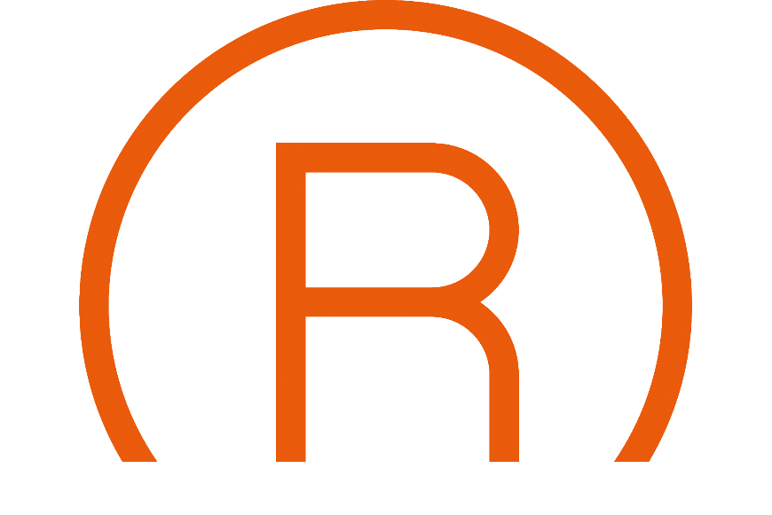
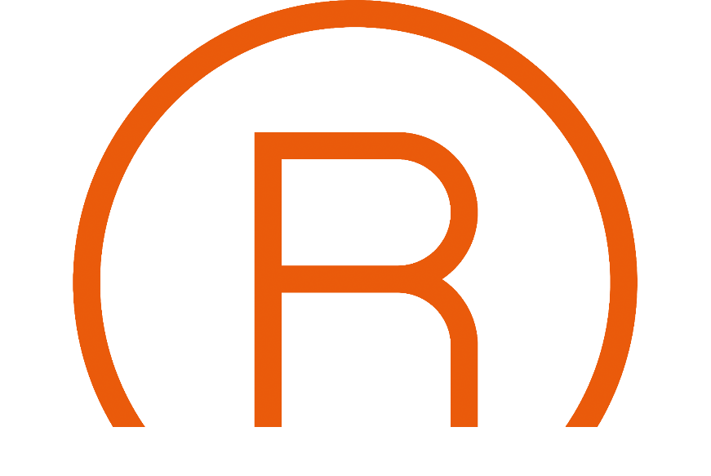
Radium Die Lichtmarke.
Character, orientation, definition.
Authentic
Professional
Valuable
  with personality
  with focus
  with experience
  strong identity
  close-by
  competent
  essential
  German quality demand
  reliable

Slide 10

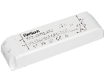


Radium Die Lichtmarke.
Character, orientation, definition.
Radium has been developing high-quality lighting solutions for the electrical trade for over 120 years. We combine expertise and experience to create sophisticated quality products:
Traditional lamps
LED lamps
LED strips and accessories
Radium
Ralotronic
Ralux
Ralogen
Brand name
Other
Trademark name and figurative mark

Slide 11
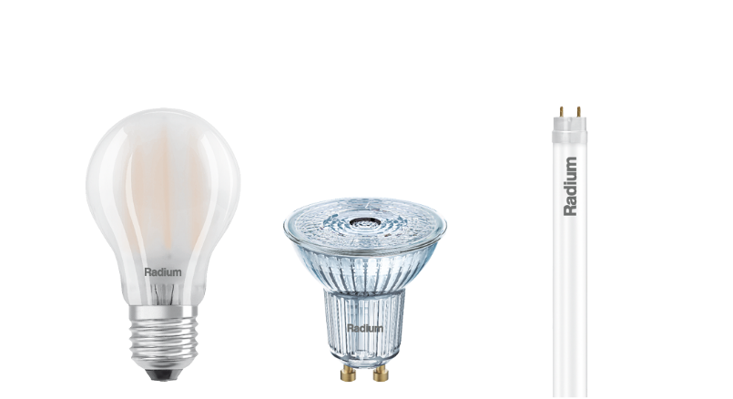
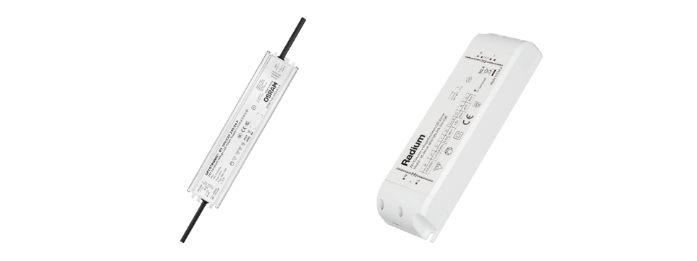
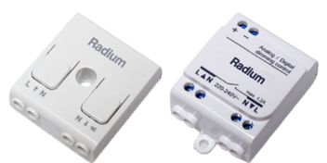
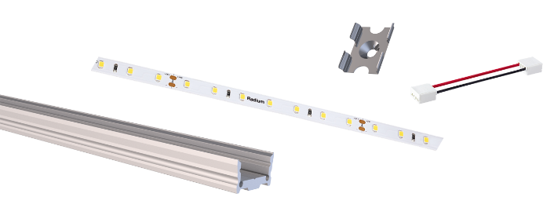
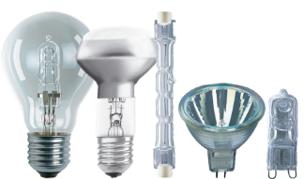
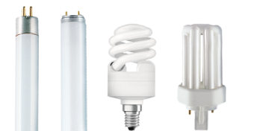
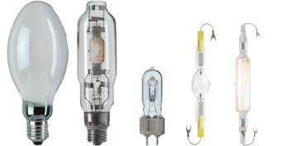
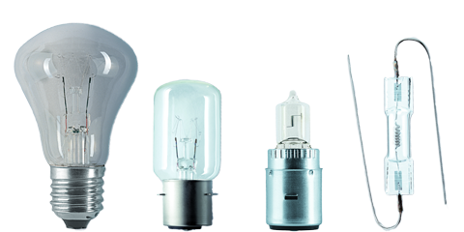
The portfolio for general lighting.
Light for any kind of application.
LED lamps
LED-Strips &
Acessories
Drivers &
Dimmers
Smart Lighting
Halogen lamps
Fluorescent
lamps
High pressure
lamps
Signal lamps

Slide 12

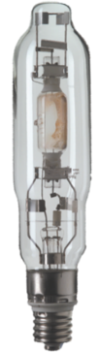


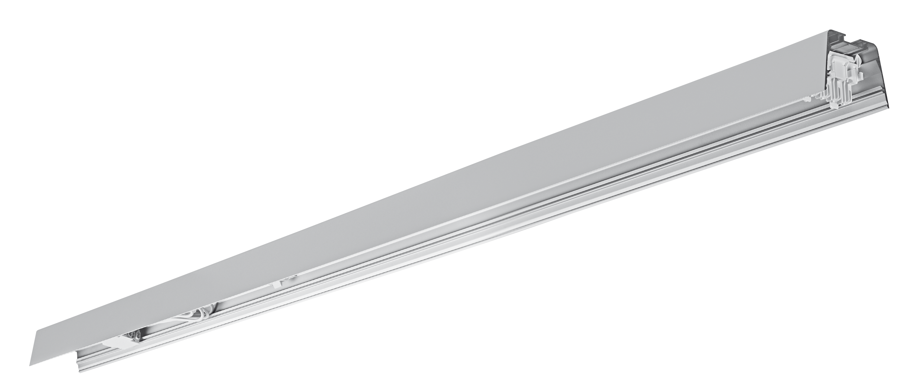

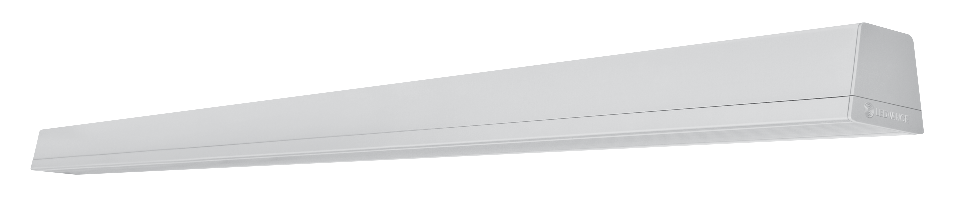
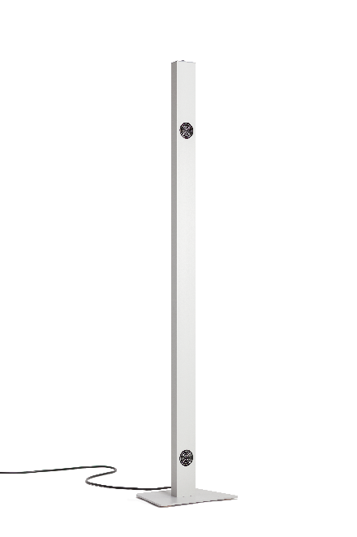
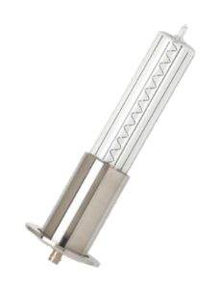
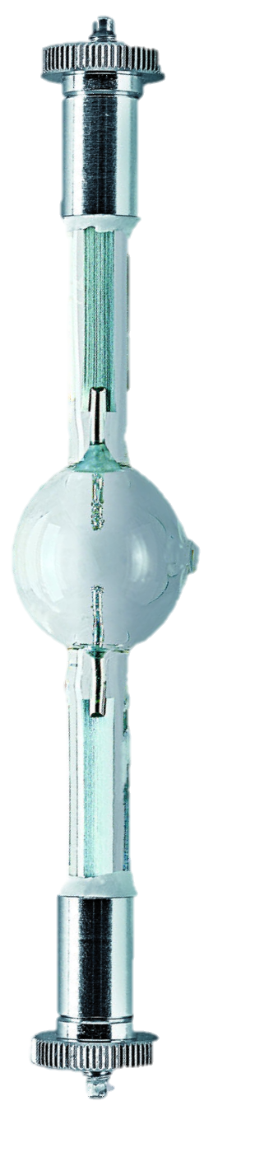
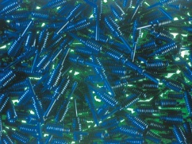
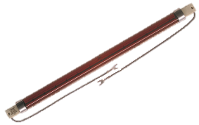
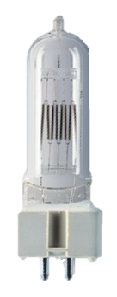

Radium in-house production.
Industry in the heart of the Bergisches Land.
RaLEDina (LED linear lamps)
High-voltage halogen lamps: Halogen tubes
Metal halide lamps:
  with quartz burner ≥400W, coloured
UV and infrared special lamps
  IR halogen tubes, UV burner high pressure
Photo lamps:
  Halogen studio lamps, spotlight lamps, daylight lamps
Signal lamps for navigation lights
Pre-products:
  Electrodes, filaments, lamp fillings, etc.
LED lighting systems (Trusys)
RaLUX® UV-C Stand

Slide 13

From lamp manufacturer to solution provider.
Digitalisation, focussing, specialising.
Product pyramid
Distribution Models
Light solution
LED Products
Traditional lamps
Lighting controls, Smart project planning, Customized solutions
Wholesaler
OEM
Lamps, Strips, Components
General lighting
Installer
Technical light
Lamps for professional applications and special lamps
End customer
End customer

Slide 14


The Radium business units play out their strengths.
Dynamics, flexibility, consistency.
General lighting
Independent business units
1
Technical Light
UV / IR
2
2
Segments
Products
Sales
PREMIUM
Tradi-tional Lamps:
HAL
LPD
HPD
LED Lamps:
Classic
Spot
Tube
Special
LED Strips:
LED Strips Profiles
Covers
Drivers
Acces-sories
Electrical Wholesalers
International with focus on Central Europe (DE + EU)
‘Specialist Shops’
ADVANCED
BASIC
VALUE DEAL

Slide 15


Slide 16

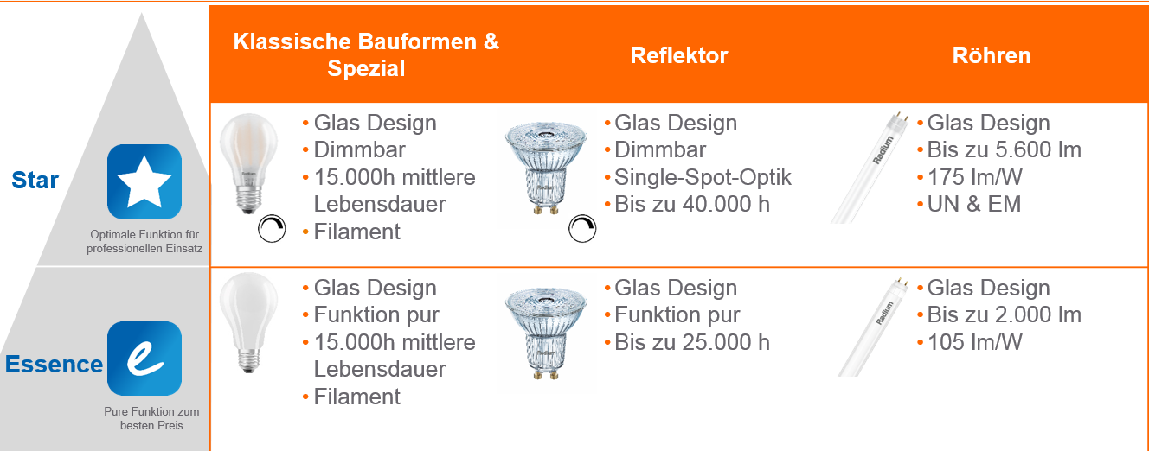

Products & Services.
LED Lamps.
Strategic measures
Expansion of the LED lamp portfolio from 74 to over 200 technical types
Focus on ‘Last Man Standing’ strategy and assessment of new partnerships
Improving product availability by digitalisation
Strengthening of customer relationships
Examples
Distribution of OP input material or lamps to other market participants
Cooperation with technology partners
Basic data for supply chain planning
Use data from website, webshop etc. to estimate forecast
Reintegration of the export business
Portfolio adjustments based on customer feedback
Fokus

Slide 17





Highlights LED Lamps.
What‘s New?
L70B50
From the entry-level portfolio to the premium portfolio
Expansion of the LED lamp portfolio to more than 200 technical types
Up to 5 years warranty on LED lamps
Glass design instead of heat sink
Better technical specifications
Longer service life

Slide 18
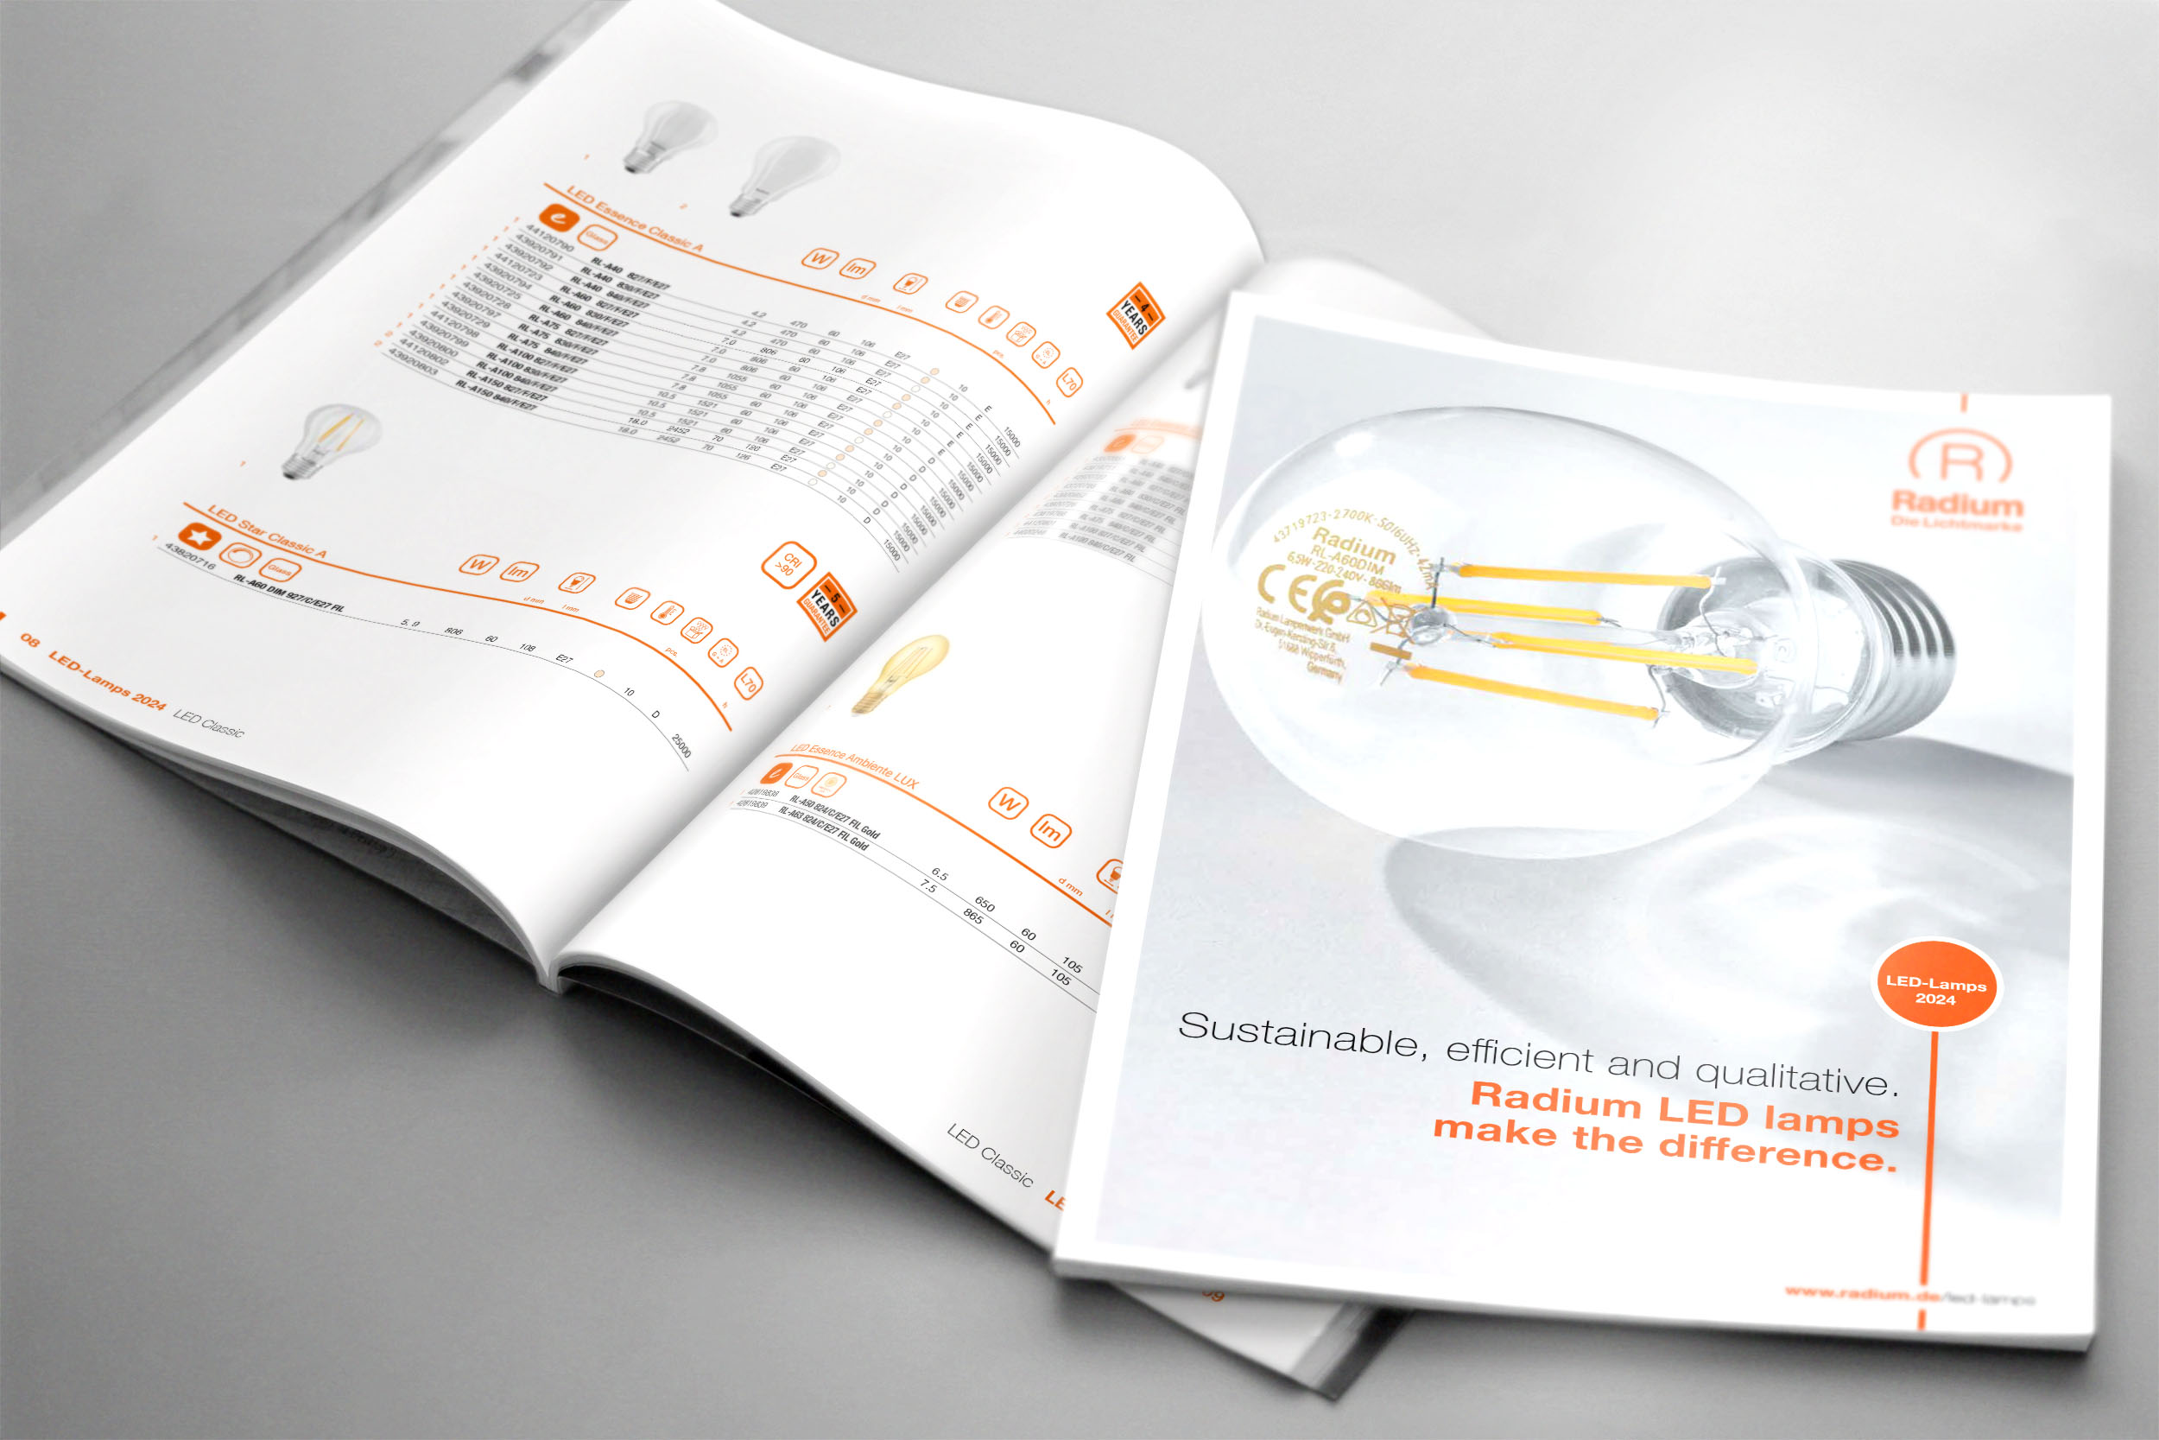
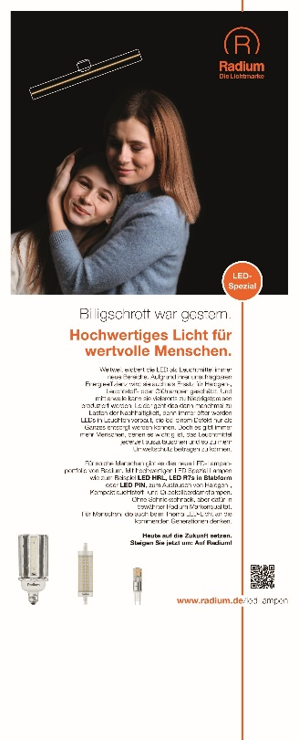
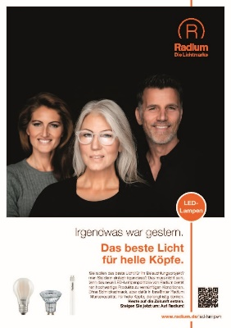
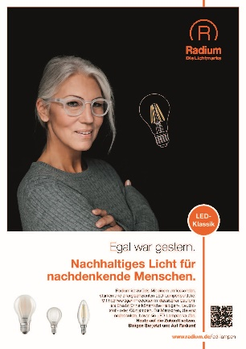
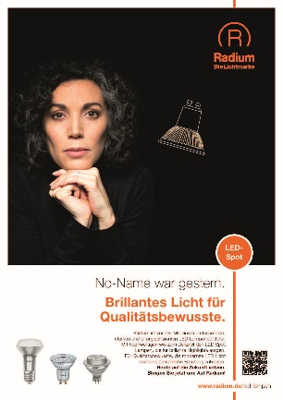
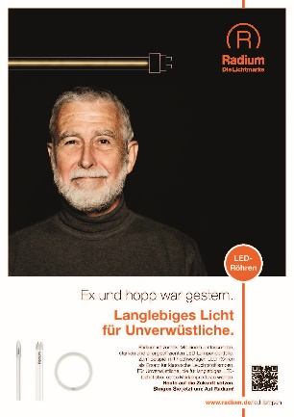
Marketing of LED Lamps.
The ‚Look & Feel‘.
Catalog available in
German, English and French
Catalog, mailings, ads, roll-ups,
social media
Landing page website
LEDs Save online tool

Slide 19
Portfolio & Services.
LED-Strips.
LED Strips
Elektronic
Accessories
Service & After Sales
LED strips in Radium brand
Extra long reels (30/50m)
Pre-wired
Customized cuts
Drivers and ballasts
Perfectly matched to the LED Strip portfolio
Profiles & covers also in customer-specific cuts
All required accessories such as mounting brackets or end caps in the appropriate amount
Software
Configurator
Database
Online Tools
Assembly & Log Interfaces
Project Support
BOM
Lighting design
Electrical planning
Mechanical planning
Commissioning
Smart Lighting
Factory
Customized solutions

Slide 20
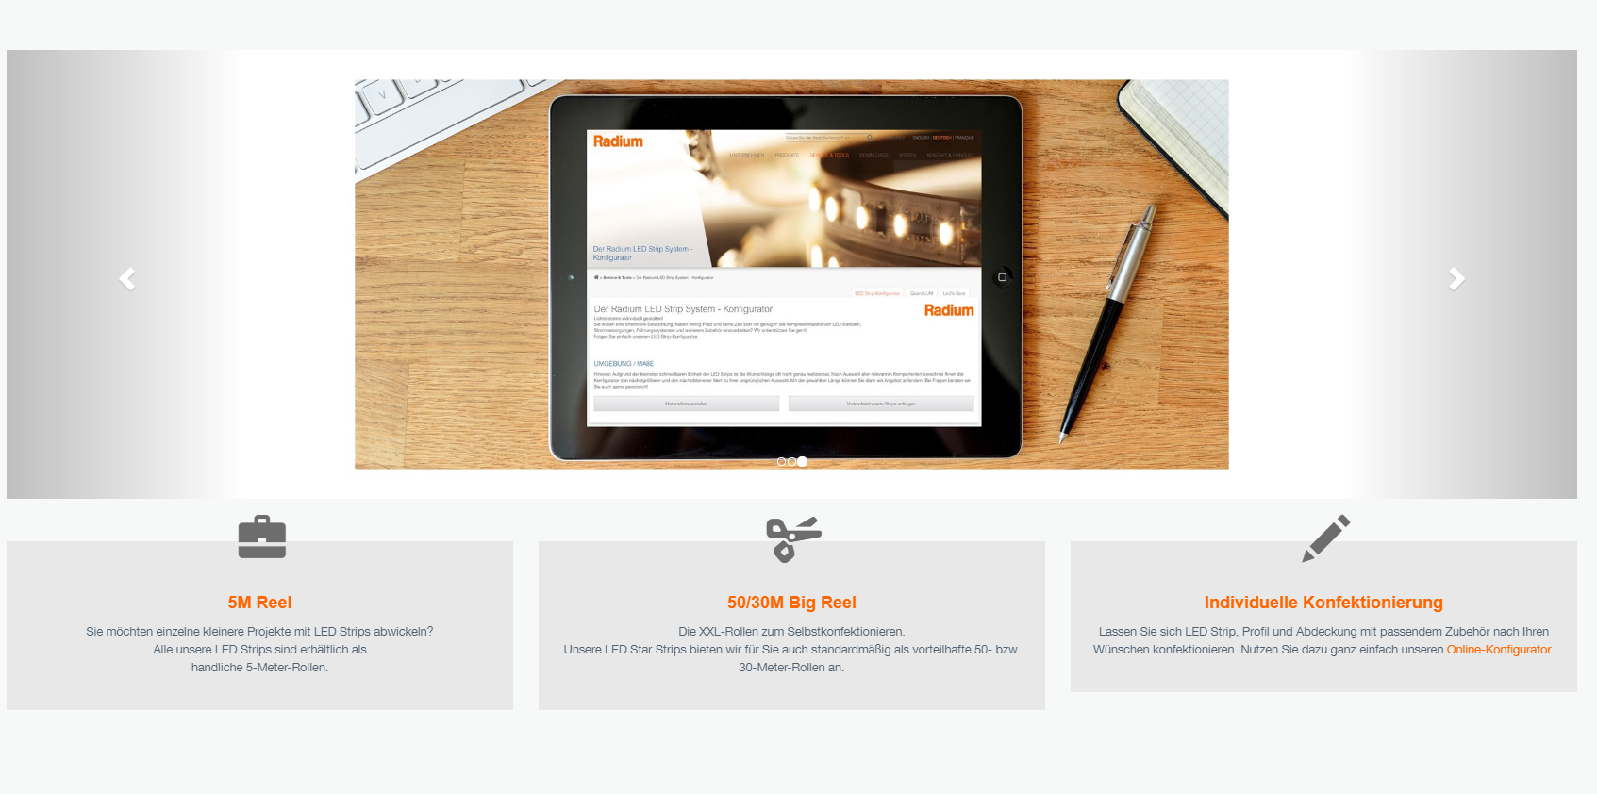
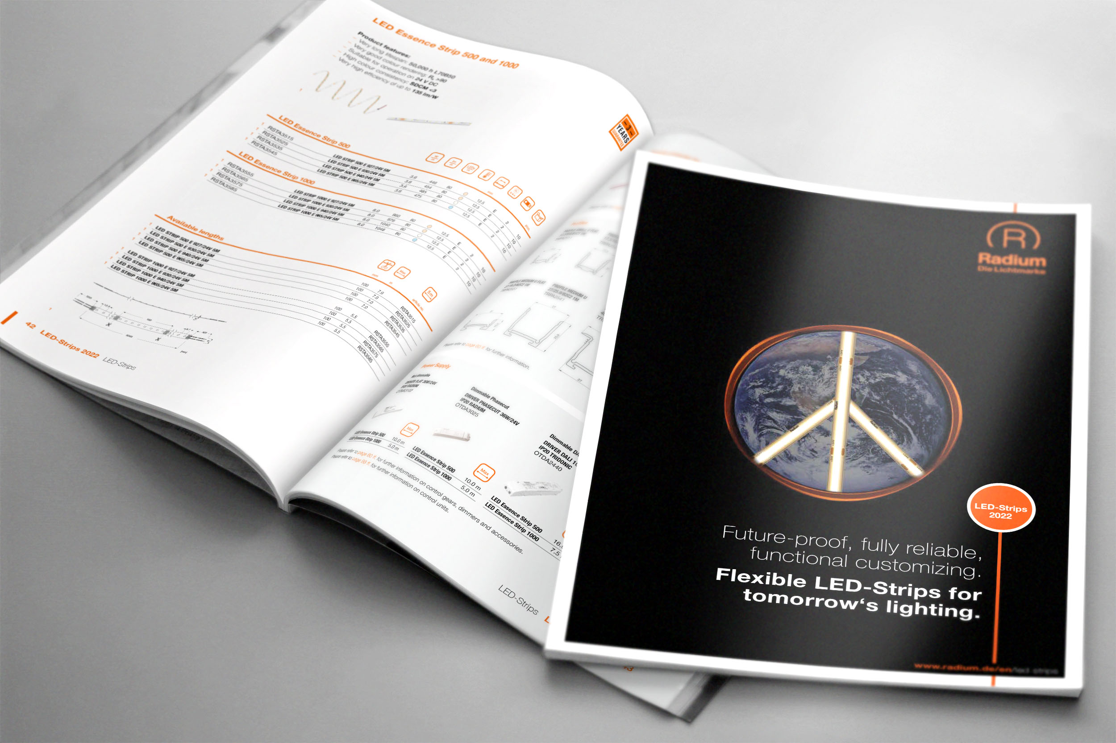
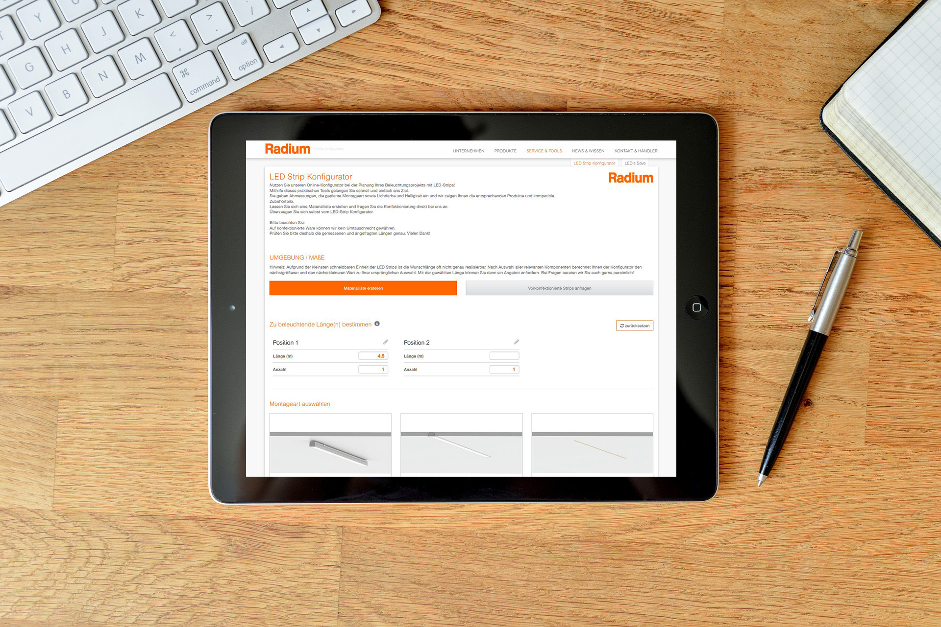
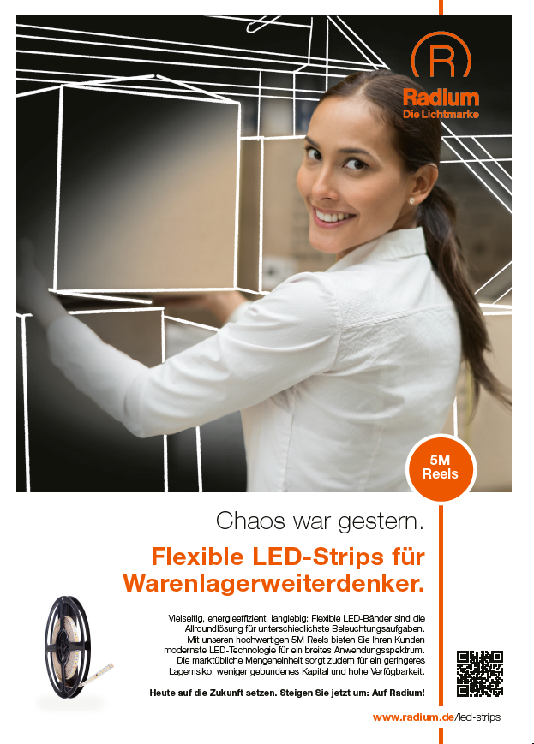
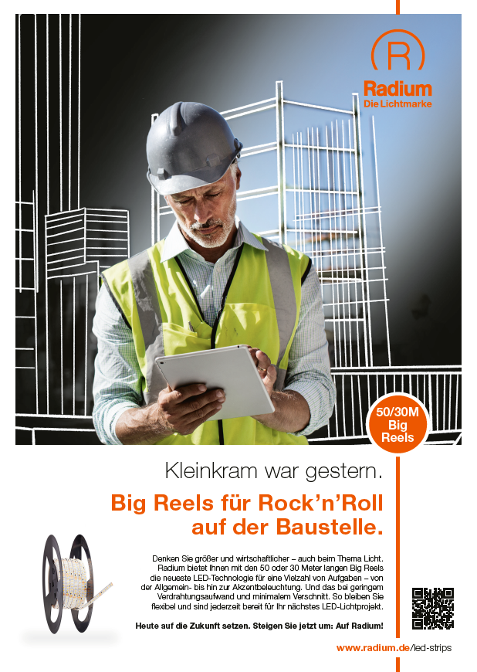
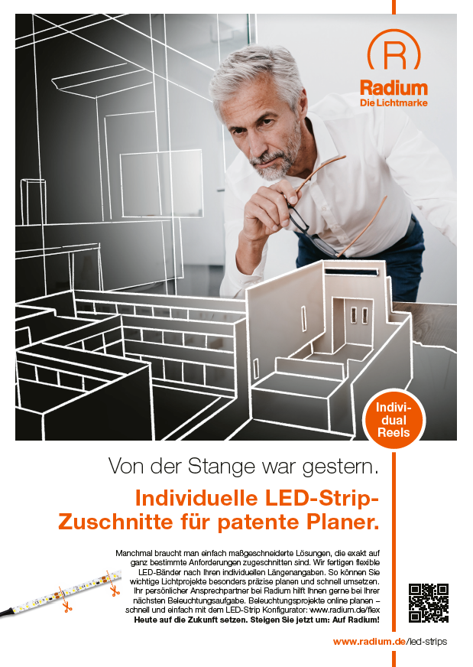
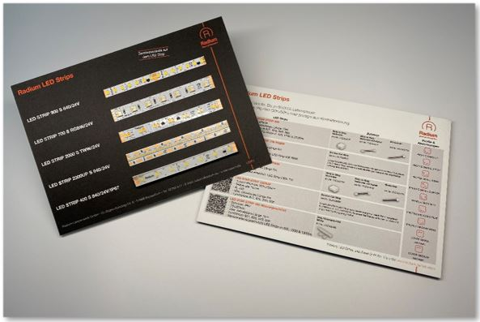
Marketing LED Strips.
LED-Strips.
Catalog available in
German and English
catalog, ads, sample card
Landing page website
Configurator on website

Slide 21


Slide 22
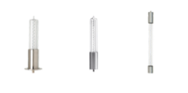

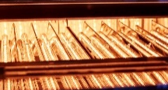

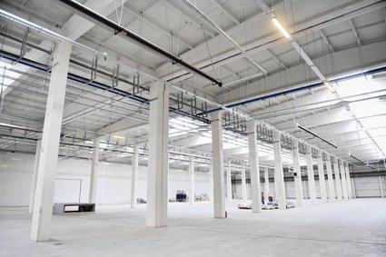
Produkts & Services.
Radium TECH.
Operates independently www.tech.radium.de
Uses the market access of Radium Die Lichtmarke and full support of Radium Trade Sales Team
UV Lamps
IR Lamps
Existing business
Products
XERADEX 172
Customized solutions
Ralotherm and Raloquick
Customized solutions
Enablers: Service & After Sales
Appli-cationen
Water treatment, air treatment, surface treatment
Heating
Production
Development
Project support
New business
New Applica-tionen
Surface treatment for aircraft wings with customized XERADEX lamps
Surface pretreatment, e.g. bonding
Indoor and industrial heating (driver: renewable energy such as solar); replacement of gas heating system

Slide 24

The human being as centre of attention.
We advise and support.
Everything according to plan
The quality and process structure of a producing factory meets the flexibility of a manufactory. We emphasise particularly the quality of our products. Our employees play an important role here, because qualified and motivated personnel is the basic prerequisite for meeting our customer's demands sustainably.
Online Configurator
The Radium Online Configurator ensures an absolutely simple way of entering your specifications. There, you are able to enter your wishes quickly, safely and transparently. Just give all the necessary inputs without much effort and let the result convince you.
Let's go: www.radium.de/en/ledstrip

Slide 25



Quality as a permanent process.
We do not leave anything to chance.
Certified according to DIN ISO 9001
Know-how of the development of the production process up to machine construction and own measurement engineering
Pre-materials of our lamps are also produced in Wipperfürth
Radium guarantees quality

Slide 26
Sustainability is an important part of our values.
We protect the environment.
Active environmental protection concerns us all: For us, it is the basis for securing the future of society as a whole.
As Radium, we feel responsible for protecting the environment by saving natural resources wherever possible and using them consciously.
This was anchored in our business policy as early as 1991: environmental guidelines were drawn up.
In 1997, these guidelines were audited and certified by an EU audit in accordance with the DIN EN 14001 standard.
By using energy-saving products, each individual can contribute to climate and environmental protection.

Slide 27
Radium Lampenwerk GmbH
Dr.-Eugen-Kersting-Str. 6
51688 Wipperfürth
Germany
Telephone +49 (0) 2267 811
Telefax +49 (0) 2267 81353 radium@radium.de
Thank you.

